Slide 1

ANNUAL GENERAL MEETING
22 November 2018

Slide 2

AGENDA
Opening and welcome
Apologies
Minutes of the previous AGM and matters arising
Chairperson’s Report
CEO’s Report
CFO’s Report
Approval of 2017/18 Annual Financial Statements and Annual Report
Approval of 2019/20 Business Plan and Planned Budget
BANKSETA Board Members
General
Closure

Slide 3

CHAIRPERSON’S REPORT
22 November 2018

Slide 4
CEO’S REPORT
22 November 2018

Slide 5
VISION AND MISSION
VISION
To be recognised as a centre of excellence and innovation for skills development in the broader banking and microfinance sector.
MISSION
To support transformation and people development and through partnerships to enable stakeholders to advance the national and global position of the broader banking and microfinance industry.

Slide 6
MANDATE
In terms of the Skills Development Act, 97 of 1998, BANKSETA was established on 20 March 2000 for a five year period ending March 2005. This was extended for another five years on 03 March 2005.
Subsequent to the move to the Department of Higher Education and Training in 2010, the Minister of Higher Education and Training further announced on 9 November 2010 that the BANKSETA be re-established for an additional five years until 2016 and from there has been re-established until 31 March 2020,
Further Government Gazettes have been publishing seeking consultation on the proposed SETA landscape (National Skills Development Plan) and the proposed mergers between SETAs beyond 31 March 2020.
Notes:
The BANKSETA attended the NSA hearings and as part of the feedback indicated that it was not opposed to the mergers but required that the rationale for mergers be articulated and also highlighted some concerns in respect of practical implementation of amalgamation and dilution of risk.

Slide 7
FUNCTIONS
Develop and implement a sector skills plan
Promote learning programmes and register agreements for learning programmes
Liaise with the QCTO regarding occupational qualifications and perform any functions delegated to it by the QCTO
Collect and disburse skills development levies allocated to it in terms of the SDA
Liaise with the National Skills Authority on the national skills development policy, the national skills development strategy, and its sector skills plan

Slide 8
FUNCTIONS (CONTINUED)
Submit to the Director-General budgets, plans and reports as required
Liaise with appropriate bodies in placement opportunities and between education and skills development providers and the labour market
Liaise with the skills development forums established in each province
Appoint staff necessary for the performance of its functions
Perform any other duties imposed by the SDA or the SDLA

Slide 9
PERFORMANCE INFORMATION
NSDS Goals
Employers Submitting WSPs
Unemployed Entered
Unemployed Completed
Employed Entered
Employed Completed
SETA / TVET / University partnerships
Lecturer Development Entered
Math and Science support entered
Math and science support Completed
Co-operative, NGO and SME Support
Career Guidance Events
Rural Development Projects
Notes:
Pages 19-27 Outline of our sub-progammes
Achievement of all programme and sub-programme targets except for one sub-programme (Doctoral and Post-Doctoral Bursaries) due to fewer people applying for this type of funding. Target achievement and non-achievement will inform the planning for the following financial year/s.
87.5% (28) achievement of 32 indicators as per DHET SLA which speaks to the NSDS goals/outcomes (see slide).
APP aligns to the totals of SLA.
African Expansion Conference

Slide 10
HUMAN RESOURCES
As at March 2018, BANKSETA comprised of 59 full time staff members. A total of 6 (six) interns were accommodated for work place integrated learning.
BANKSETA retained its accreditation for being an Investor In its “People” (employees).
Performance Management System was been reviewed, embraced and reinforced internally.
BANKSETA made some strides in the achievement of its disability target sitting at 3,5%. Focused recruitment and other talent management strategies are being aligned to EE Plan.

Slide 11
GOVERNANCE
Details of Board and Board Committees (consisting of Executive, Finance and Remuneration and Audit and Risk) as per Standard Constitution of SETA Regulations (Skills Development Act)
Attendance at meetings and remuneration levels
Internal Audit
Risk Management
Corporate Governance Aspects – sound with no reports of non-compliance (also refer to Administration Programme)

Slide 12
2019/20 STRATEGIC PLAN
Administration Programme:
An efficient and effective SETA that complies with legislation, policy and good corporate governance principles
Skills Planning Programme:
A credible sector skills planning mechanism that identifies relevant skills priorities to meet the labour market demands for the banking and alternative banking sector
Learning Programmes:
Responsive, sector-aligned skills development interventions addressing the objectives of the NSDS III and the identified skills priority actions in the sector skills plan to address occupational shortages and skills gaps
Quality Assurance Programme
Provision of occupation based qualifications to support the supply of skills utilising a work based route to the acquisition of post-school education and training

Slide 13
RESEARCH AND SECTOR SKILLS PLANNING
Change drivers
Driver 1: Digitisation and Technology
Driver 2: Changing Customer expectations
Driver 3: Cybercrime and Broader Financial Crime Risk
Driver 4: Disruptors in Banking
Driver 5: Economic and Political Uncertainty
Strategic Priority Actions
Skills Priority Action 1: Technology, Digitisation and Analytics
Skills Priority Action 2: Risk Management and Compliance
Skills Priority Action 3: Management and Leadership Development
Skills Priority action 4: Core banking products/services
Skills Priority Action 5: Customer Relationship Management

Slide 14
CFO’S REPORT
22 November 2018

Slide 15
FINANCE OVERVIEW
Sound financial performance that mirrors attainment of performance targets.
9% increase in SDL – sector banks performing well
All expenditure in line with mandate and legislation
20% increase in DG expenditure mainly within critical skills.
Maintained 97% claim ratio for mandatory grants
Admin expenditure R13 million below admin budget
Research expenditure increased by R7 million
Sound financial position 90% assets in cash and cash
equivalents supported by commitments at 61%
17 years of clean audits

Slide 16
SETA FUNDING MODEL (unchanged)
Employers pay 1% SDL on total payroll and bonuses
Investment income (on funds not immediately needed)
Other Contributions and donations
Levy Penalties & Interest
SARS/DHET (levies ringfenced )
BANKSETA (80% of levies)
NSF get 20%
49.5% used to fund Discretionery Grants in line with sector priorities and APP
0.5% to Fund QCTO Costs to the QCTO
20% Mandatory Grants back to Qualifying Employers
10% to fund Administration cost of the SETA

Slide 17
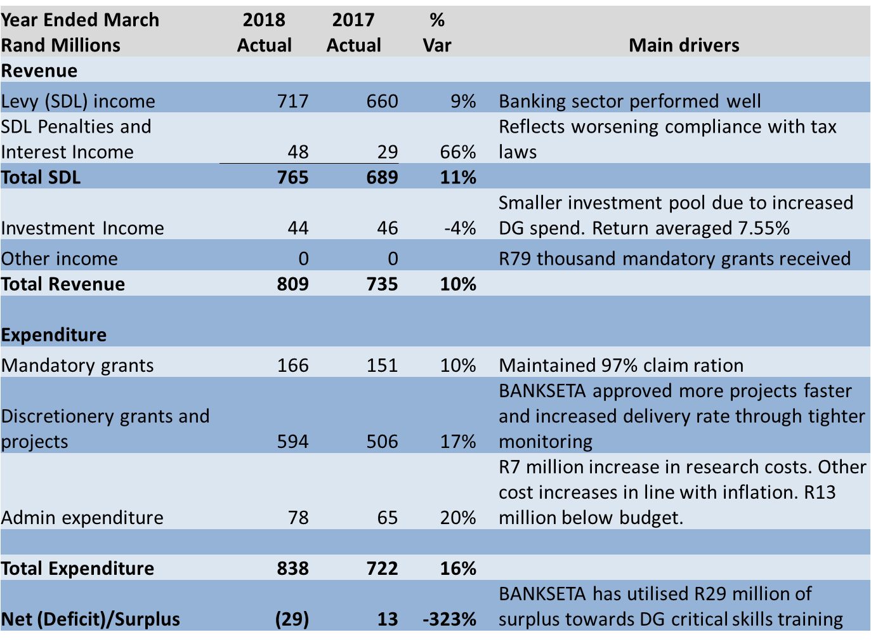
2017/18 FINANCIAL PERFORMANCE

Slide 18
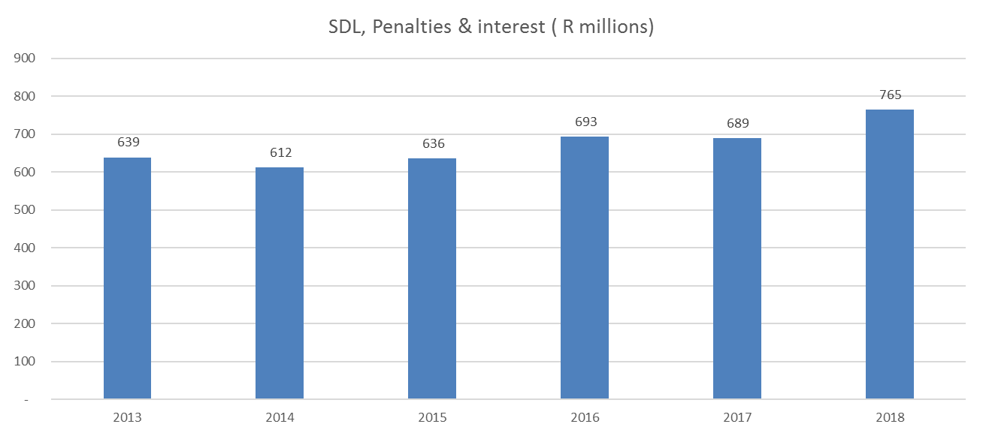
SDL, PENALTIES AND INTEREST

Slide 19
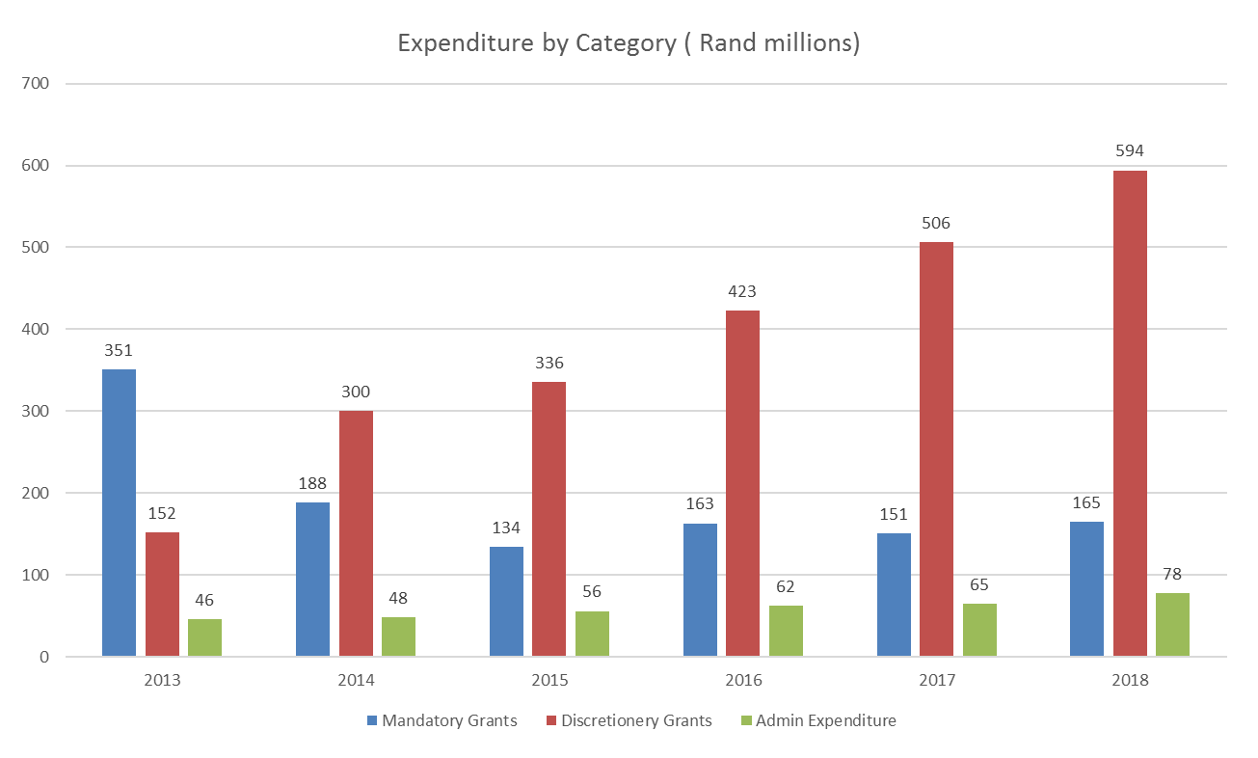
EXPENDITURE TRENDS

Slide 20
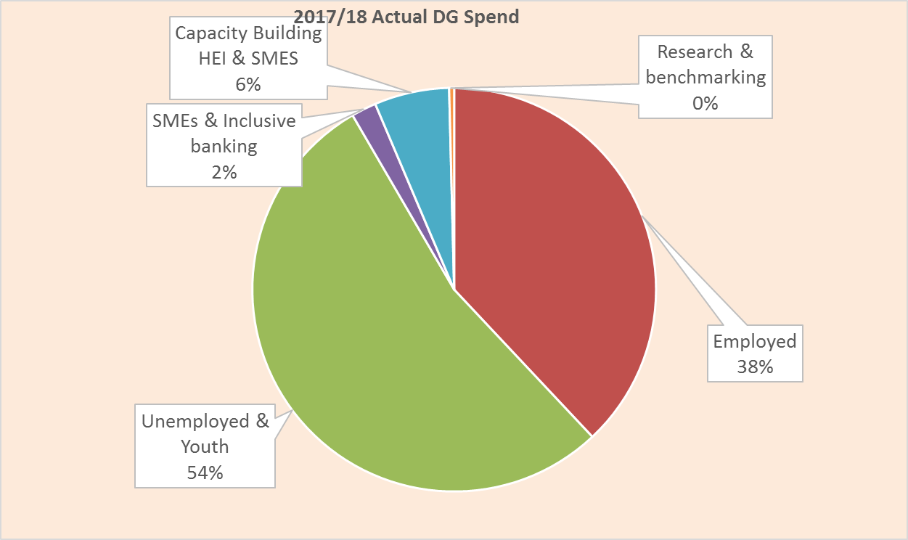
DISCRETIONARY GRANT SPLIT

Slide 21
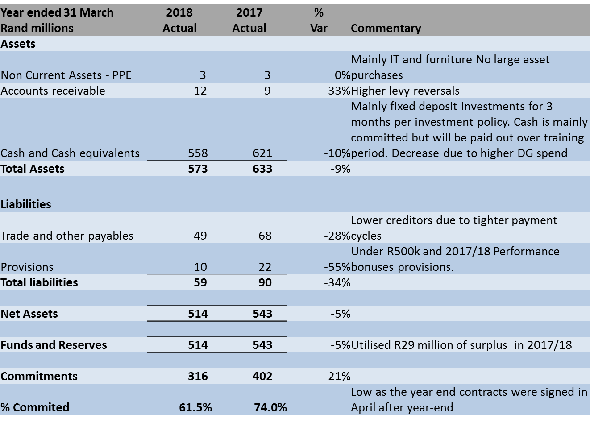
2017/18 FINANCIAL POSITION

Slide 22
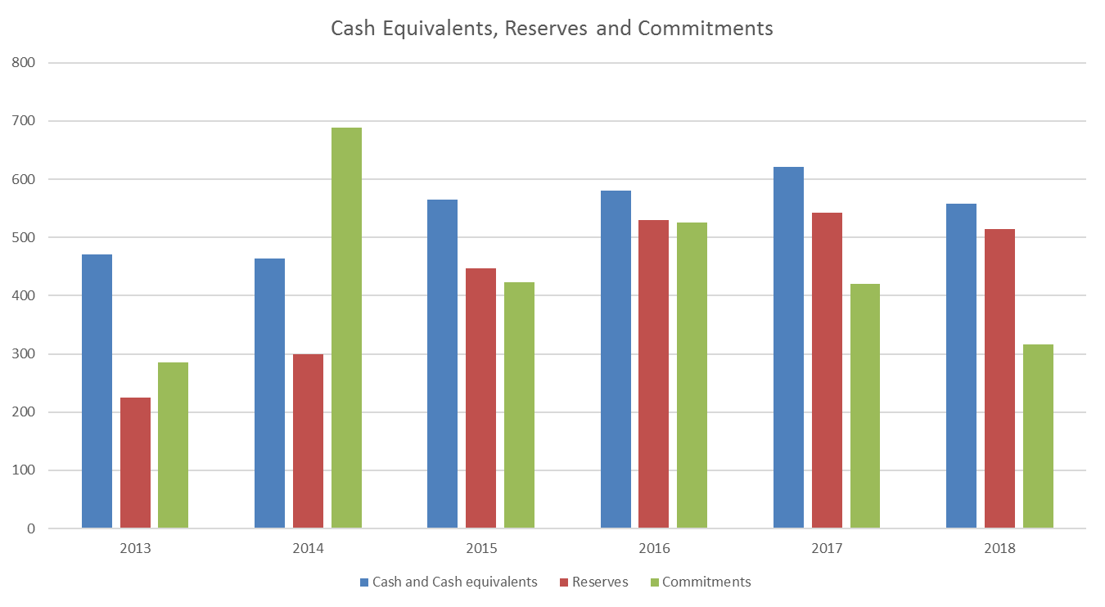
2017/18 FINANCIAL POSITION (CONTINUED)

Slide 23
2019/20 PROPOSED BUDGET
22 November 2018

Slide 24
2019/20 PROPOSED BUDGET OVERVIEW
Public entities set budget six months before year end, therefore budget proposal has been approved by board.
Last year under current licence. No change in funding model
Inflation estimated at 5%.
Levy growth kept at inflation levels to reflect salary increases. No employment growth factored in.
Expenditure inflation at 5%.
Maintained 97% claim ratio for mandatory grants
DG fund showed minimal growth as it has already surpassed 49.5% in prior year.
Any surpluses from 2018/19 will be added to DG budget for 2019/20.
National Treasury has approved BANKSETA plan to budget for a R30 million deficit and therefore utilise R30 million of reserves.

Slide 25
2018/19 PROPOSED BUDGET

Slide 26
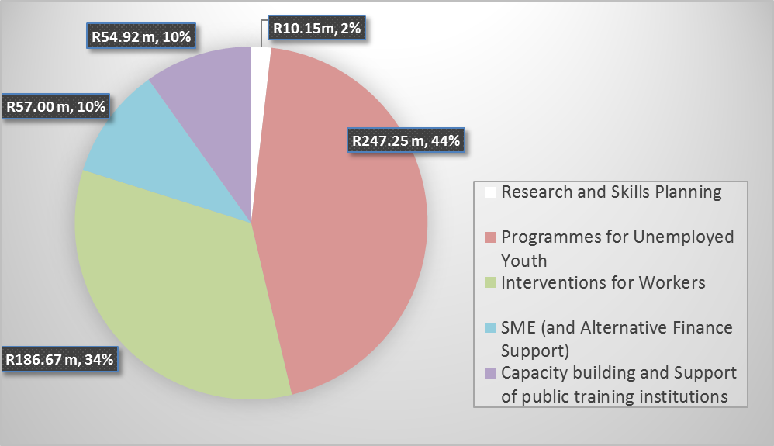
2019/20 PROPOSED
DISCRETIONARY GRANT SPLIT

Slide 27
BANKSETA BOARD MEMBERS
22 November 2018

Slide 28
BOARD MEMBERS (1/04/2018-31/03/2020)
Independent Chair:
Nosipho Mia Makhanya
Representing Organised Labour:
• Joe Kokela (Sasbo)
Malesela Moses Lekota (Sasbo)
• Samantha Anthony (Sasbo)
• David Cedras (Sasbo)
• Noxolo Jonas (Sasbo)
• Lebo Selepe (Sasbo)
Representing Organised Employers:
• Lucy Voss-Price (South African Reserve Bank)
• Dean Retief (Nedbank)
• Myen Moodley (Standard Bank)
• Israel Noko (MFSA)
• Vasinthee Moodley (FirstRand Bank)
• Vacancy (Absa)
Representing Community:
• Malesela Maleka
• Sabi Padi

Slide 29

QUESTIONS
ENABLING SKILLS DEVELOPMENT IN THE BANKING AND ALTERNATIVE BANKING SECTOR

Slide 30
THANK YOU
ENABLING SKILLS DEVELOPMENT IN THE BANKING AND ALTERNATIVE BANKING SECTOR

